Slide 1
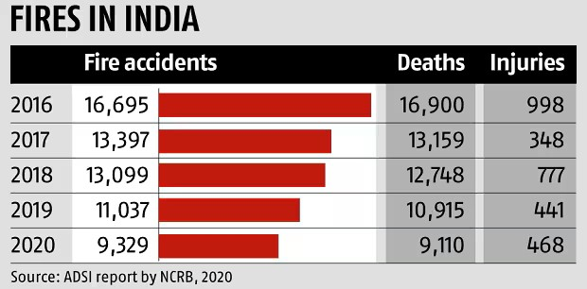
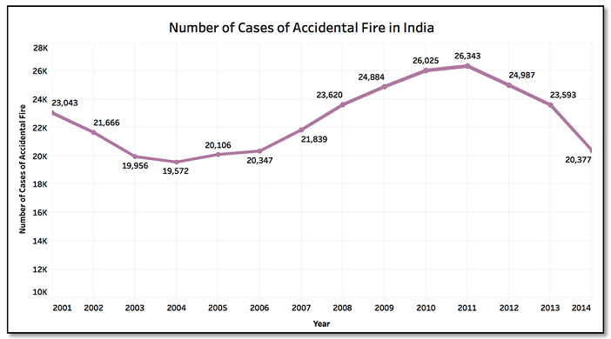
Introduction
Fire accidents are a significant global issue, causing thousands of deaths and billions in property damage annually. In 2022, U.S. fire departments responded to 1.3 million fires, resulting in over 3,500 deaths and $15 billion in losses. In India, fire accidents are equally devastating, with over 18,000 fire-related deaths reported each year, according to the National Crime Records Bureau (NCRB). Many incidents occur in remote or densely populated areas where rescue efforts are hindered by delayed response, limited access, and outdated firefighting methods.
Our autonomous fire extinguisher drone addresses these issues with rapid deployment, real-time fire and human detection, and active fire suppression. Using machine learning, thermal sensors, and live data, it enhances emergency response and protects lives, particularly in hard-to-reach areas.

Slide 2
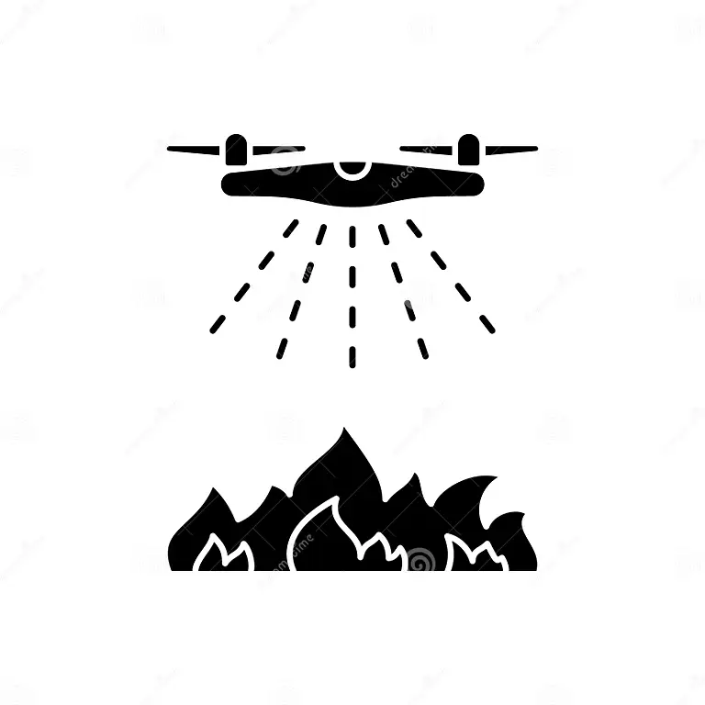
FireGuard: Autonomous Fire Extinguisher
Solution:
To Overcome this problem we have introduced a autonomous fire extinguisher drone that Operates independently to navigate and address fires efficiently.
Unique points:
Dual Detection Capabilities: The drone is equipped with advanced sensors and machine learning algorithms to simultaneously detect fire and locate humans in the vicinity of danger zones.
Live surveillance: High-quality live footage from the onboard camera is streamed directly to rescue teams, enabling real-time assessment of the situation.
Onboard Extinguishing System: Equipped with an efficient fire-suppressant mechanism, the drone actively reduces fire intensity until professional help arrives.
Autonomous Deployment: The drone can be activated remotely upon receiving a message from a GSM module, eliminating the need for manual intervention.

Slide 3
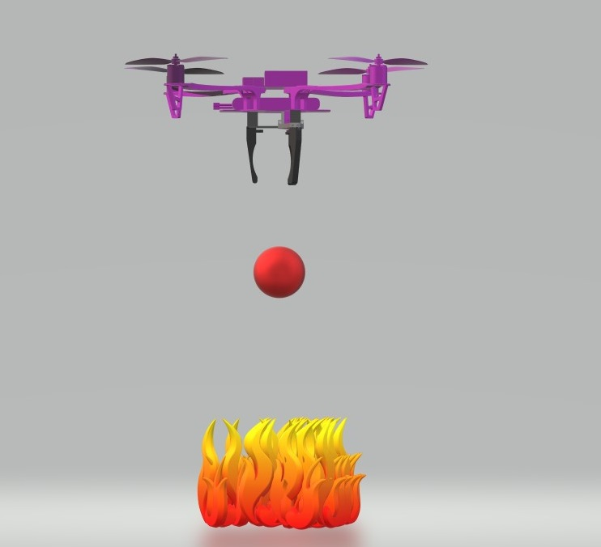
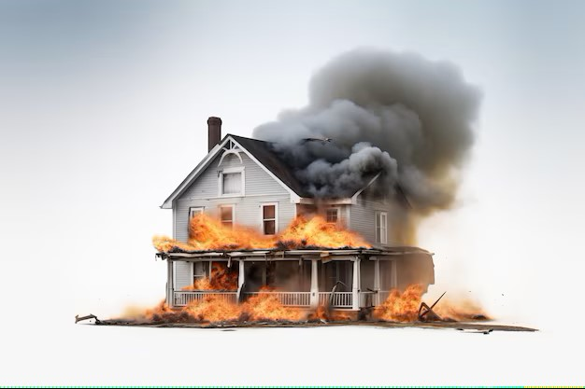
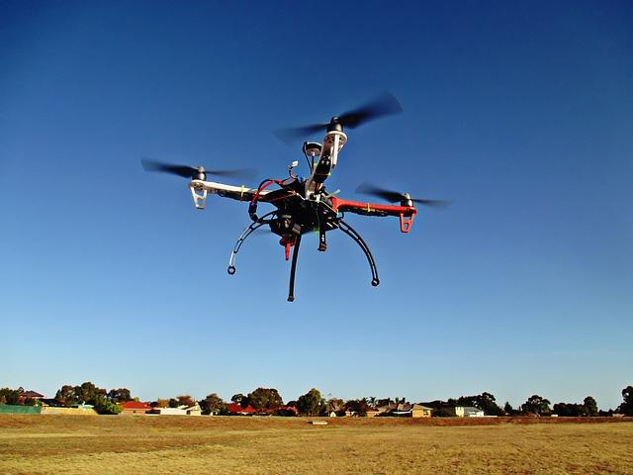
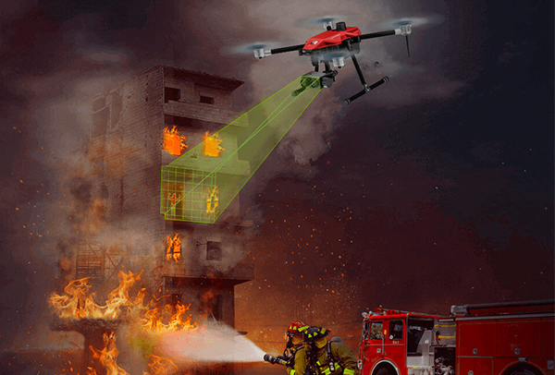
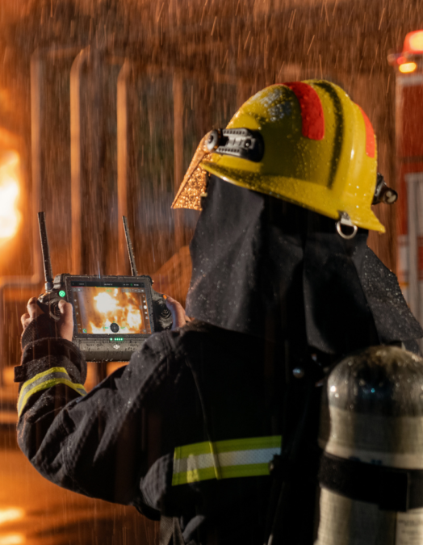

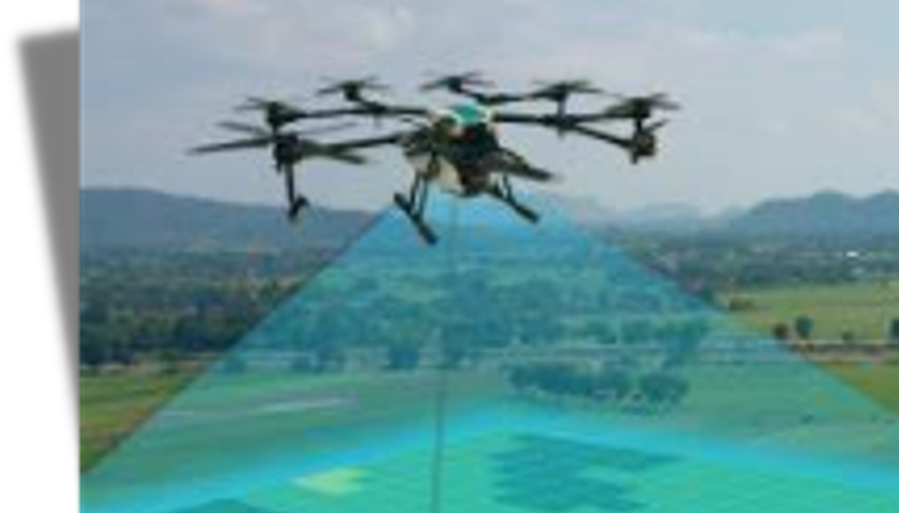
Working Process
Fire Accidents Occurs
Drone Takes Off
Detects Fire And Humans
Fire Extinguishing
SOS alarm
Surveillance Process

Slide 4


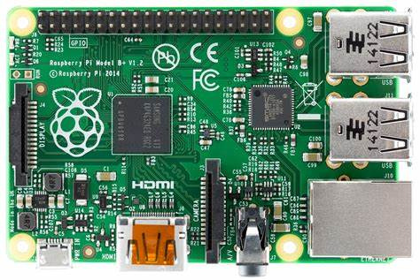
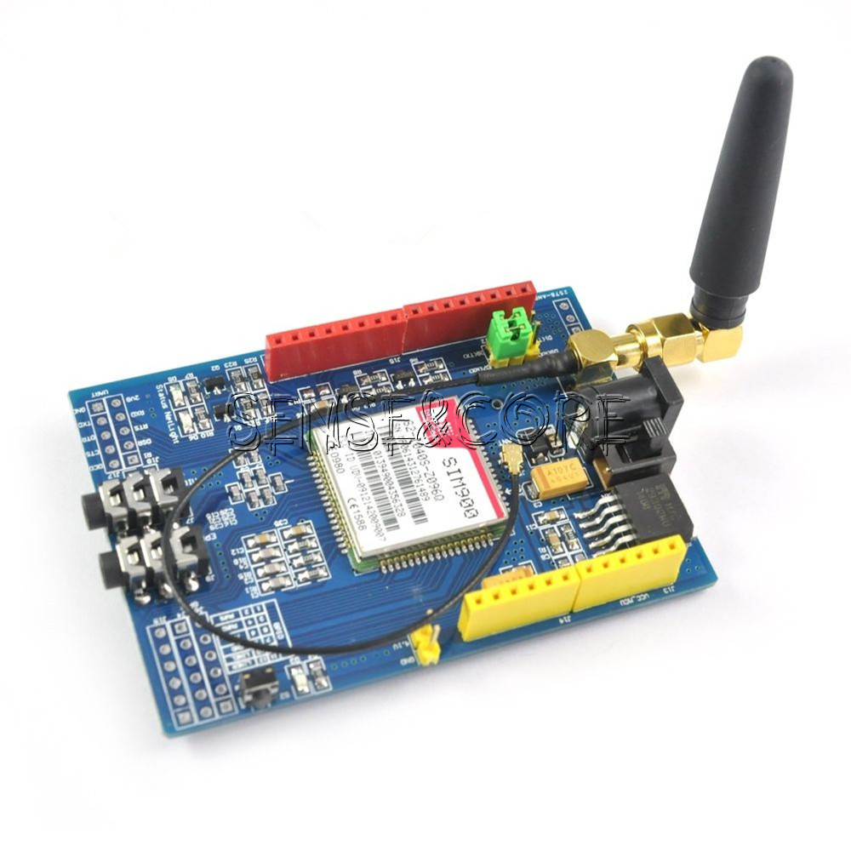

TECHNICAL APPROACH
Hardware Components :
Pixhawk 2.4.8
Raspberry pi 5
Logitech Camera
GSM 900A Module
Servo Motors
Extensive Datasets: Models are trained on large collections of fire images and small videos.
Varied Scenarios: Includes diverse fire conditions and environments.
Enhanced Accuracy: Improves detection capabilities by learning from a wide range of fire situations.
Libraries Used:
OpenCV
Pytorch
Ultralytics
Datasets Used:
Kaggle Dataset
Models Used:
Yolo V8 Model

Slide 5
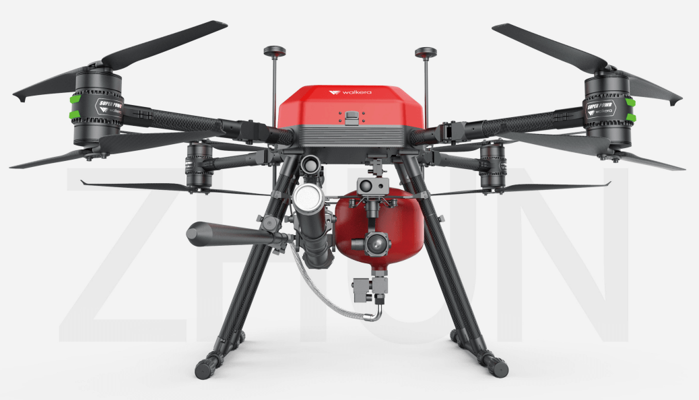
IMPACT AND BENEFITS
Potential Impact on the Target Audience
Emergency Responders:
Efficiency: Enhances real-time response and control.
Safety: Reduces exposure to fire hazards.
Communities:
Confidence: Improves trust in emergency services.
Industries:
Risk Reduction: Lowers fire hazards in critical areas.
Continuity: Reduces downtime and losses.
Major advancements
Rapid Autonomous Deployment: The drone’s autonomous navigation system.
Advanced Fire and Human Detection: The drone accurately detects fire hotspots and identifies human presence.
Real-Time Situational Awareness: High-definition live streaming to the rescue teams immediately.
Cost-Effective and Scalable Solution: The system offers a scalable approach to fire management.

Slide 6
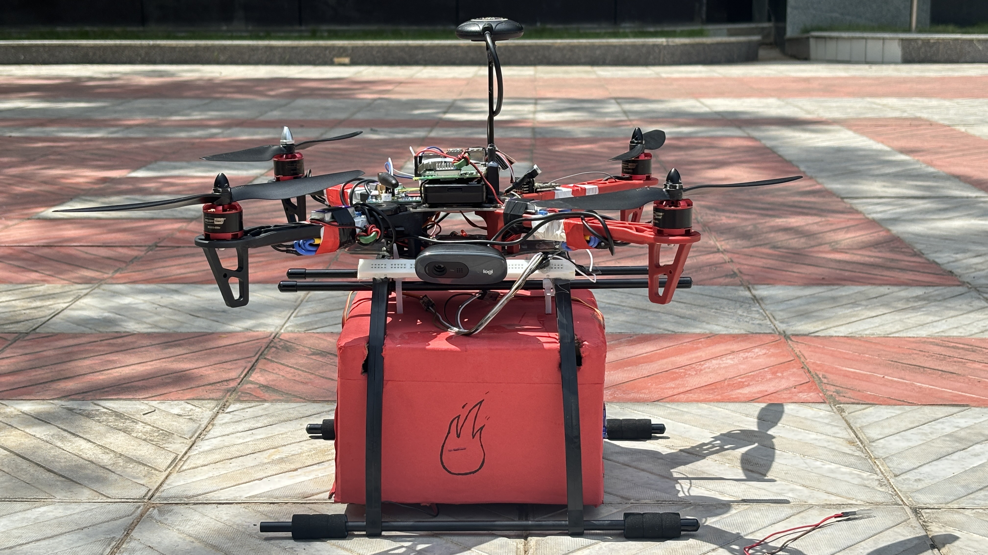
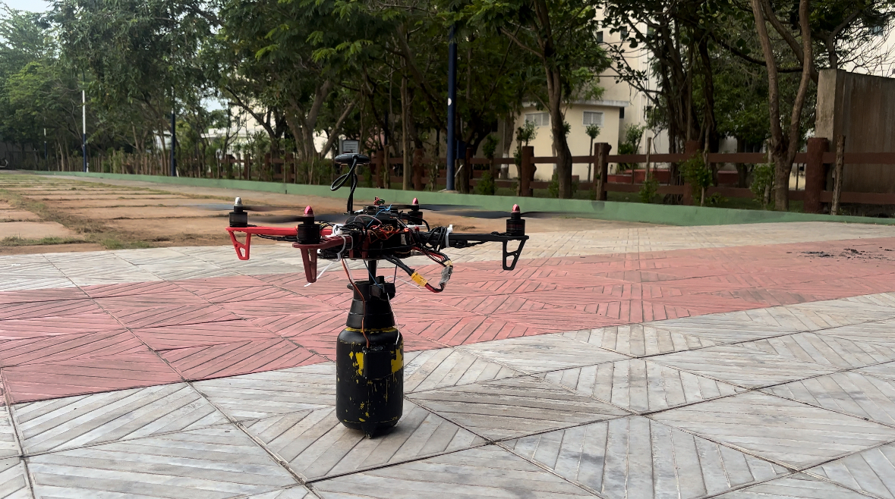
Prototype Model
Dropping Mechanism
Spray Mechanism

